Slide 1
Name : Rupali Vijay Raut Internship : Ethical Hacking Task : 2 Email: rupa1613037@gmail.com

Slide 2
Task 2:

Slide 3
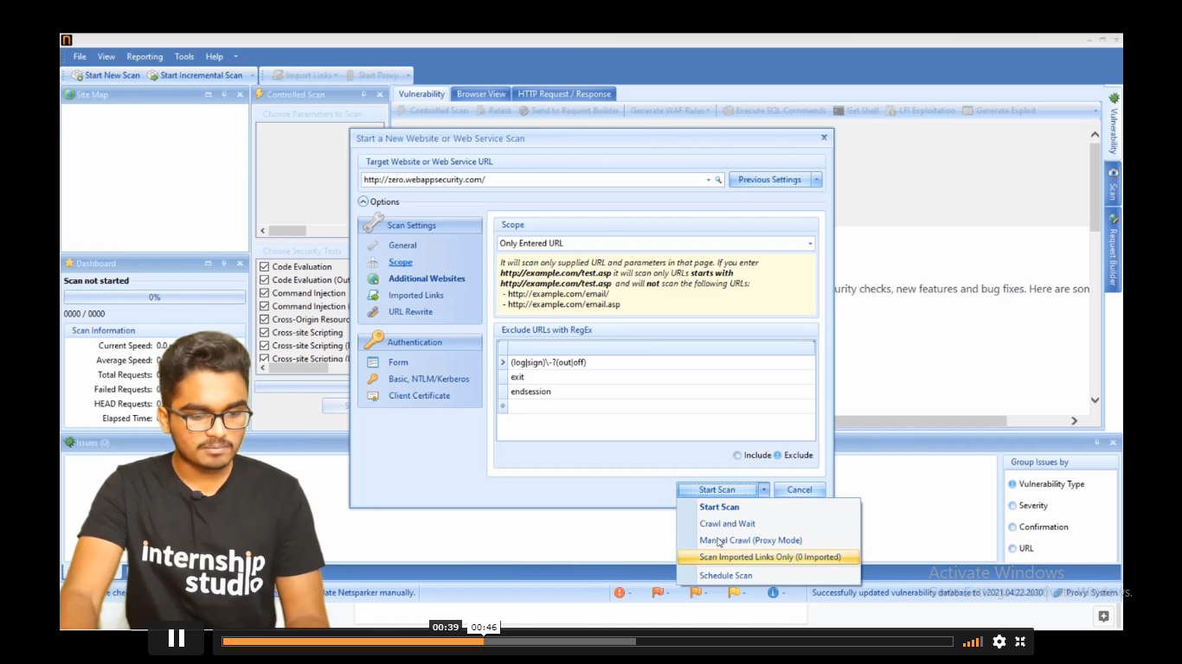
1st you need to open Netsparker, then in Url section paste this url http://zero.webappsecurity.com/ then set setting as your preference and start scanning.

Slide 4
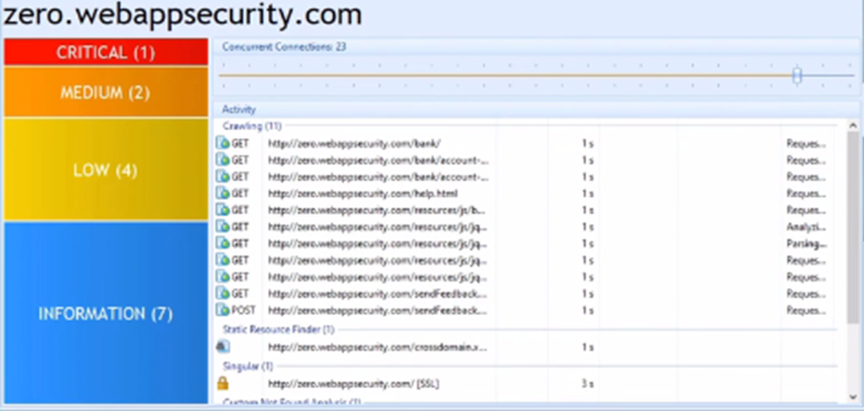
Then after clicking on a scanning you will find window as below:

Slide 5
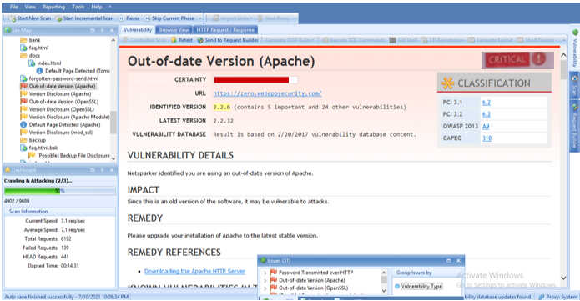
Now here we find critical vulnerability as follows:

Slide 6
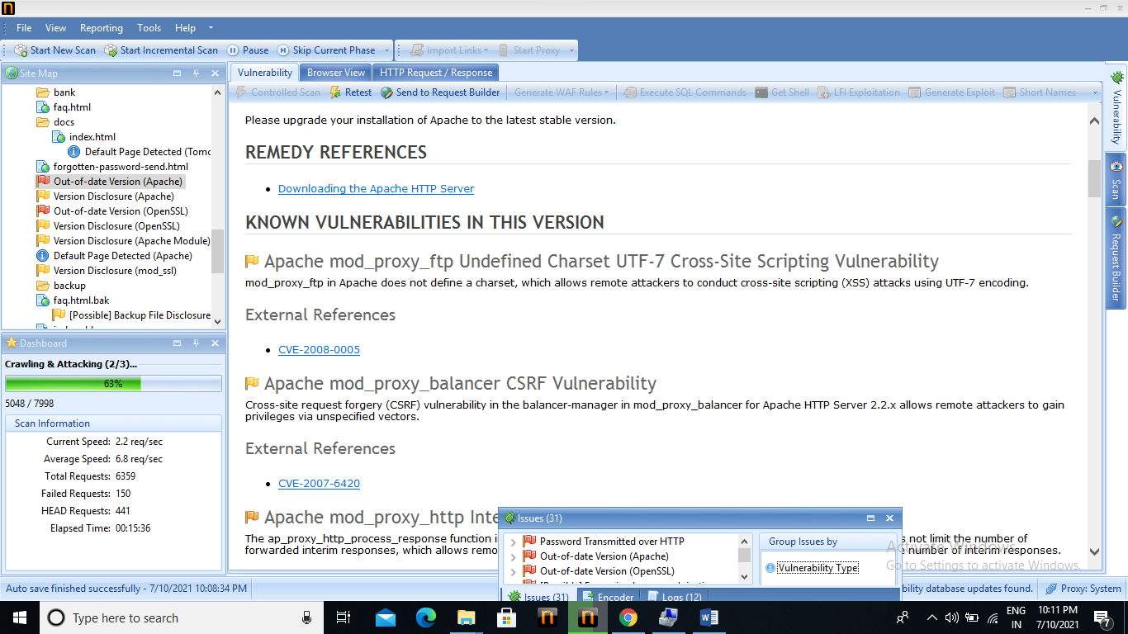

Slide 7
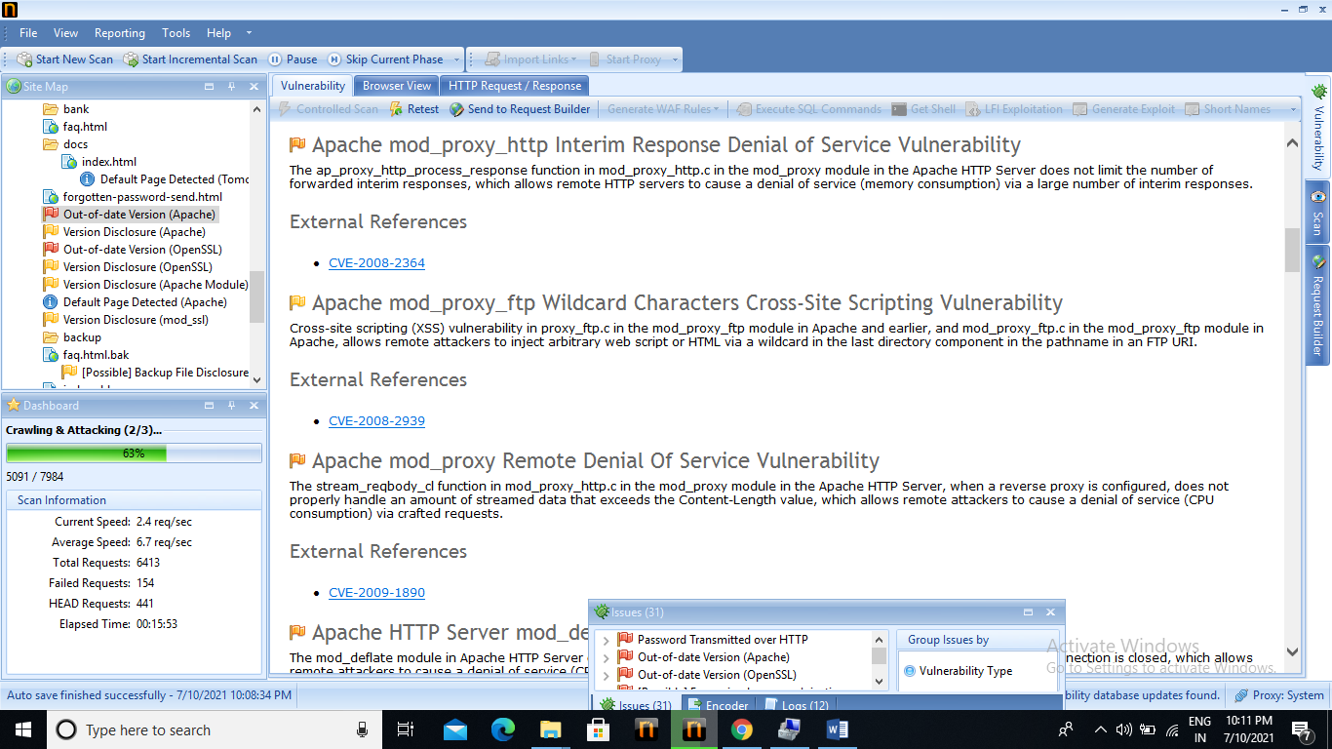

Slide 8
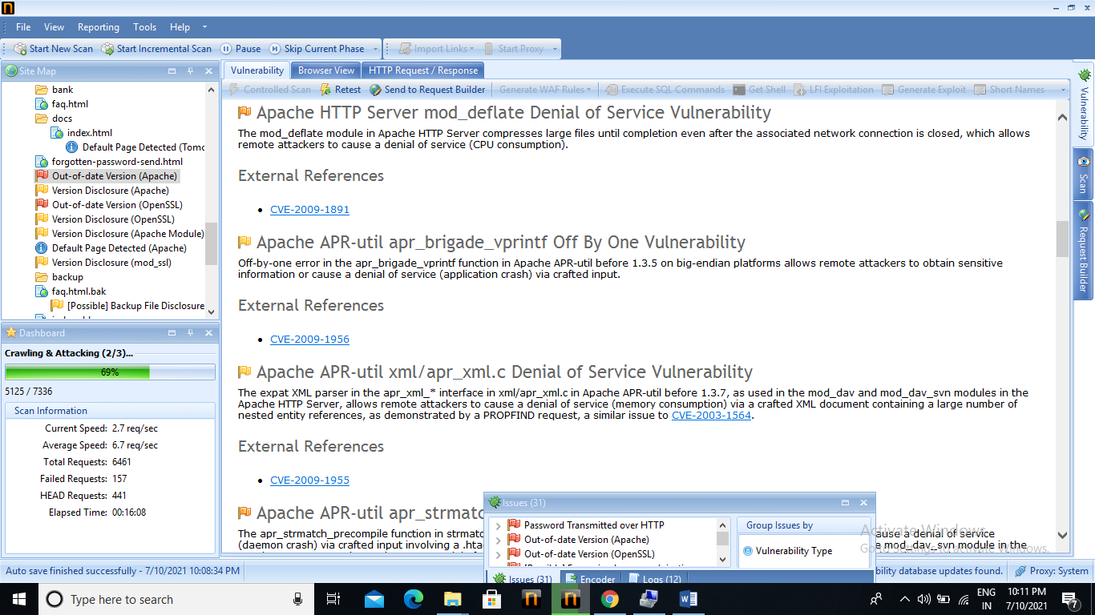

Slide 9
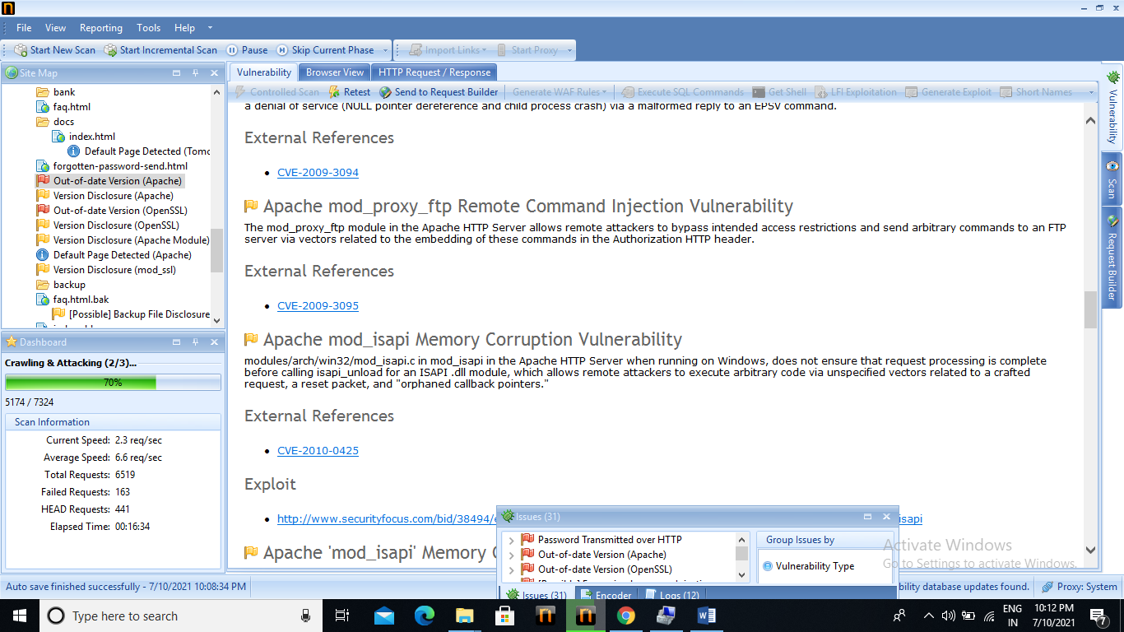

Slide 10
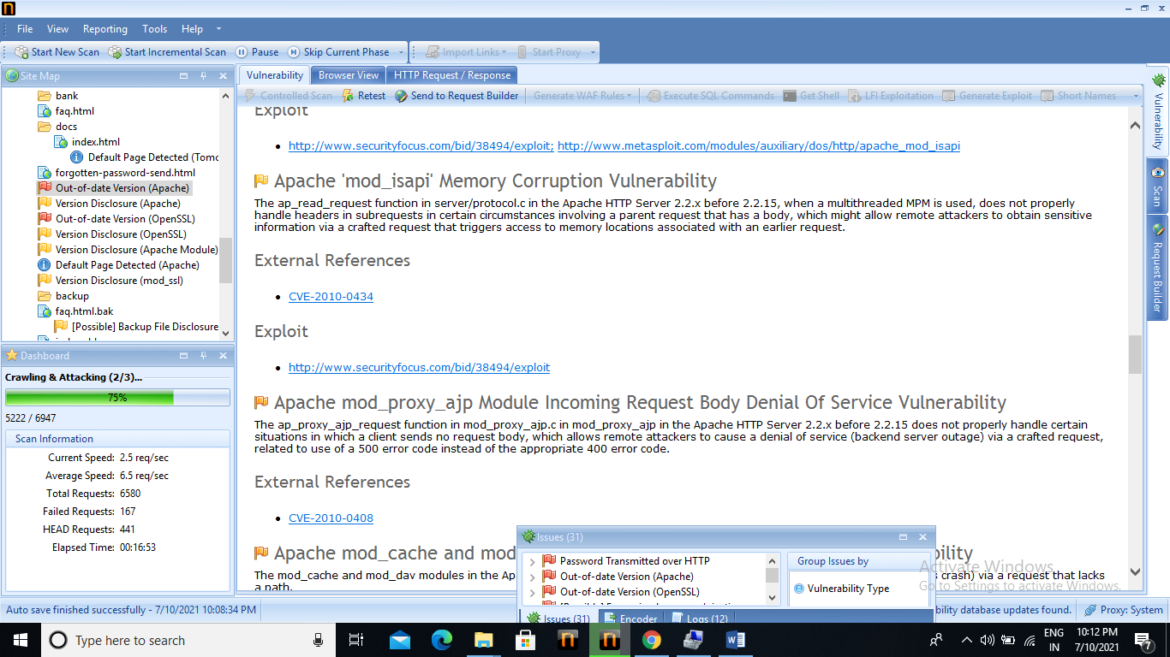

Slide 11
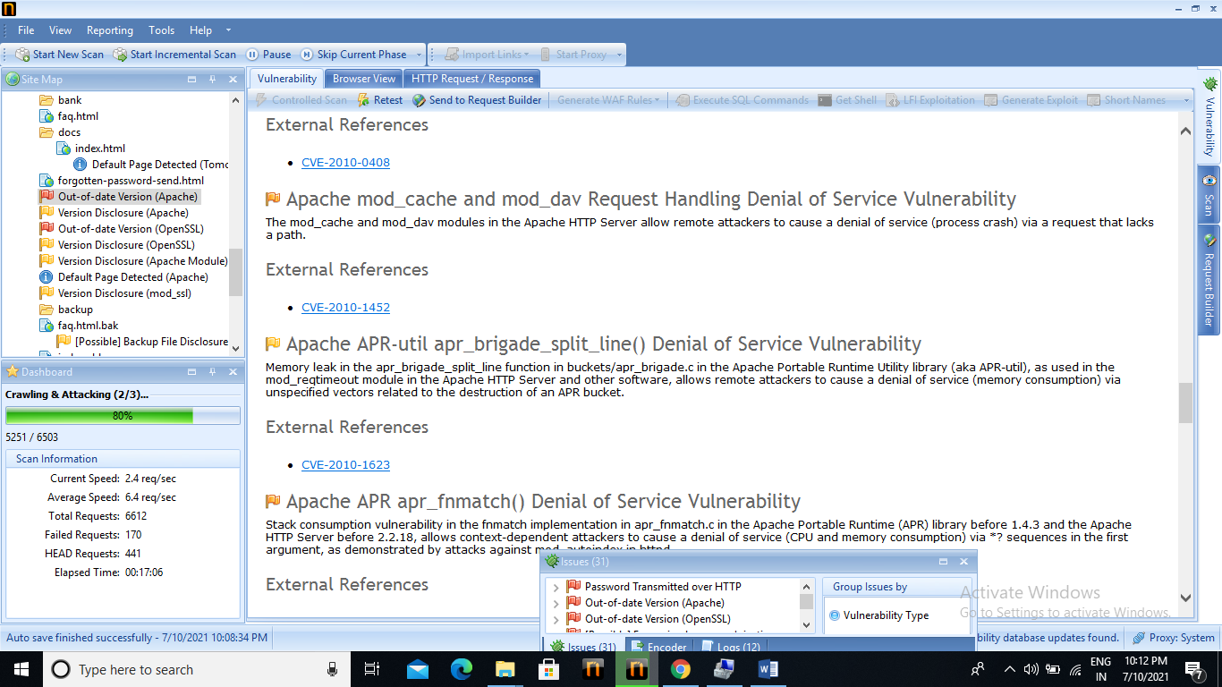

Slide 12
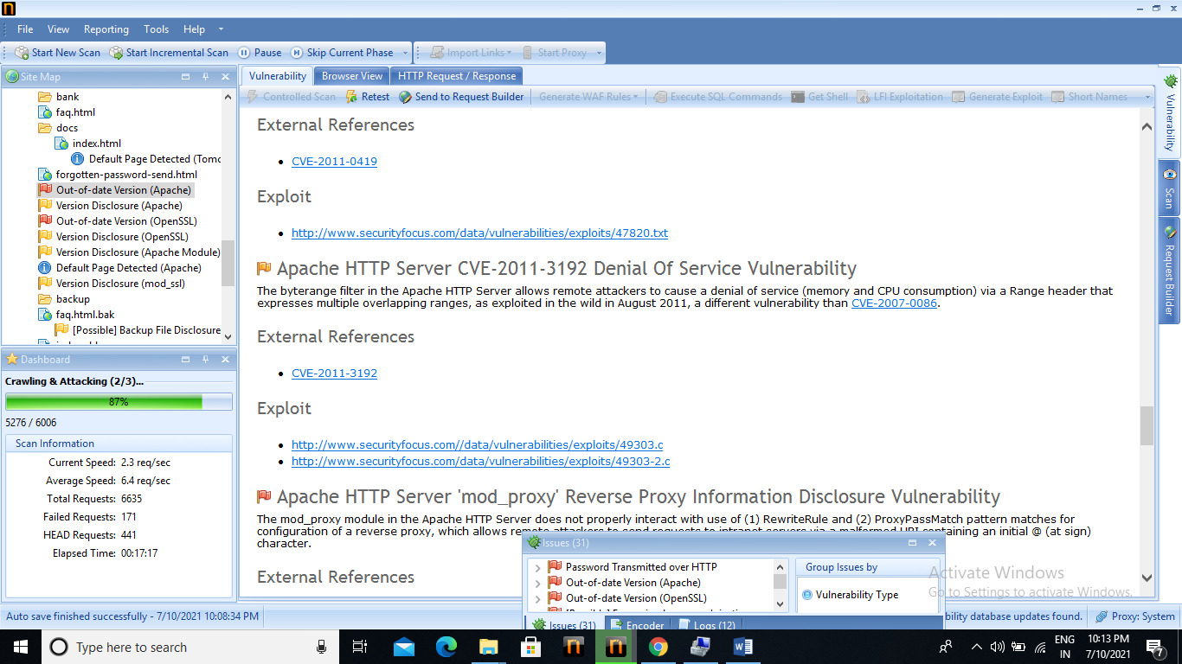

Slide 13
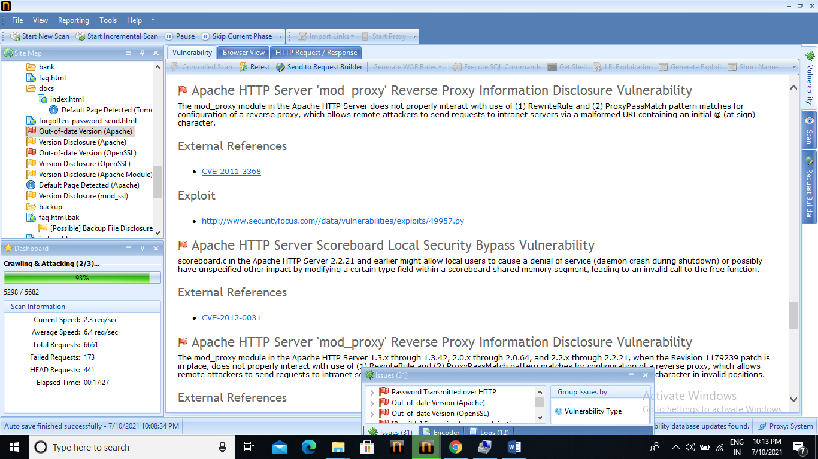

Slide 14
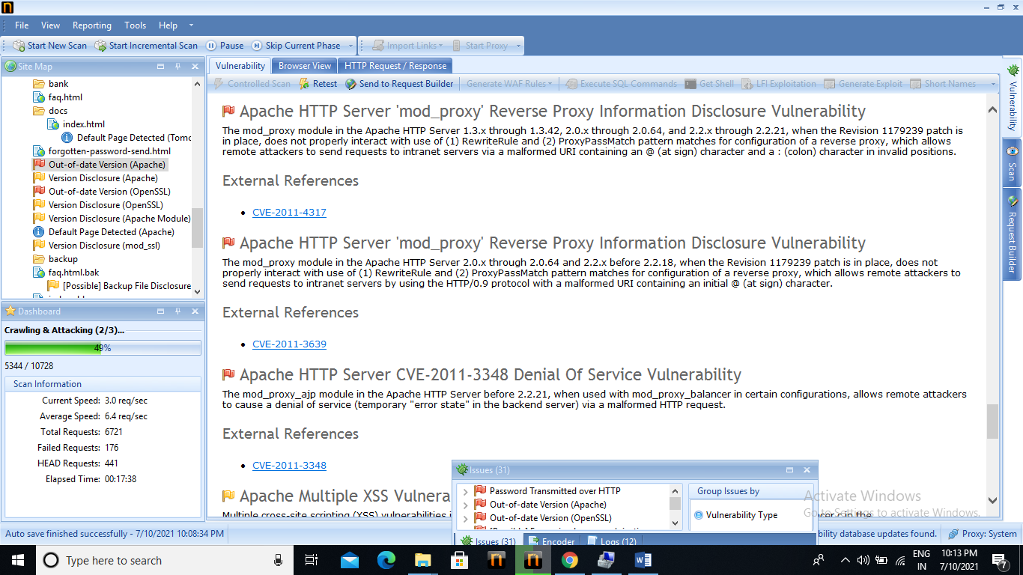

Slide 15


Slide 16


Slide 17
Report on Task 2:

Slide 18
Introduction to Netsparker:
Netsparker is an automated, yet fully configurable, web application security scanner that enables you to scan websites, web applications and web services, and identify security flaws. Netsparker can scan all types of web applications, regardless of the platform or the language with which they are built.
Netsparker is the only online web application security scanner that automatically exploits identified vulnerabilities in a read-only and safe way, in order to confirm identified issues. It also presents proof of the vulnerability so that you do not need to waste time manually verifying it. For example, in the case of a detected SQL injection vulnerability, it will show the database name as the proof of exploit.

Slide 19
Here, as I mention in above screenshot we can find critical, medium, low vulnerabilities, according to mention in task 2 we find 1 critical vulnerability and now we create a report on it. So I find the the 3 critical vulnerability and one of them is Apache(out of date version) When we scanning we identified version of apache is 2.2.6 with 5 important and 24 other vulnerabilities where the latest version is 2.2.32 and the given result is based on 2/20/2017 vulnerability database. We found the vulnerability details as follows:

Slide 20
Impact: Because of this is an old version it may responsible for attacks.
Solution: upgrade the installation of Apache to the latest version.
Solution preferences: it provides some links for downloading latest version of apache.

Slide 21
The some known vulnerabilities found in this version are :
Apache mod_proxy_ftp Undefined charset UTF-7 Cross-site Scripting vulnerability.
Apache mod_proxy_balancer CSRF Vulnerability
Apache mod_proxy_ftp Wildcard characters cross-site scripting vulnerability
Apache mod_proxy remote denial of service vulnerability
Apache mod_proxy_http interim response denial vulnerability
Apache mod_proxy_ftp Remote command injection vulnerability
Apache mod_isapi memory corruption vulnerability
Apache APR-util apr_brigade_split_line()denial of service vulnerability
Apache APR apr_fnmatch() denial of service vulnerability
:

Slide 22
Apache ‘mod_log_config.c’ denial of service vulnerability
Apache multiple xss vulnerability
Apache code Execution vulnerability
Apache mod_proxy_ajp module incoming request body denial of service vulnerability
Apache denial of service vulnerability
Apache ‘main/util.c’ denial of service vulnerability

Slide 23
Hence here I completed my task 2 successfully…….

